Slide 1



Android App
English Learning
Lecturers : Nguyễn Thanh Phong

Slide 2



MEET OUR TEAM
Nguyễn Triệu Duy
Nguyễn Minh Hiếu

Slide 3

Agenda
01
02
03
Introduction
ToolS
Line OF Code
04
05
06
DeTAils
DEMO
Experience Product

Slide 4
1
INTRODUCTION

Slide 5

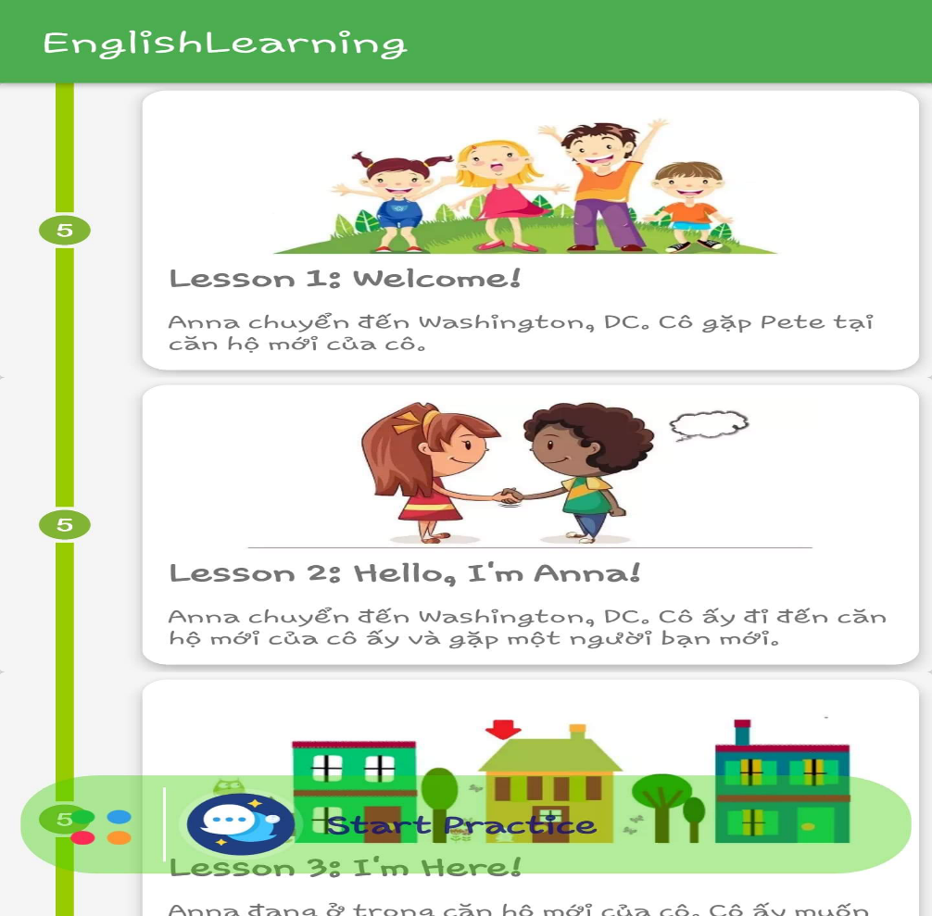
Introduction
What Is Purpose For ?
1. Help you learn American English from Learning English Program. American teachers designed the courses for learners.
2. App will be a new lesson with video showing the lives of young Americans. The lesson includes instruction in speaking, vocabulary and it’s suitable for English beginners.
3. You definitely understand about how to use vocabulary, phrase to practice speaking English with real situations.

Slide 6
2
Tools

Slide 7



Tools
Android Studio
Github
Bit Bucket
Notes:
Potential : khả năng
Encounter : gặp
Trivial : tầm thường

Slide 8
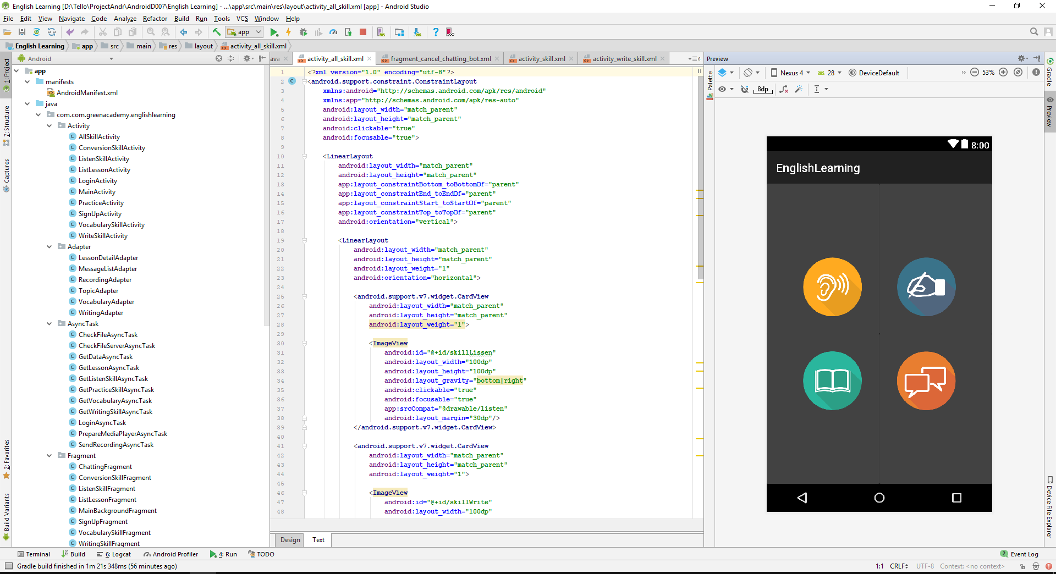
Tools
Android Studio
Notes:
Potential : khả năng
Encounter : gặp
Trivial : tầm thường

Slide 9
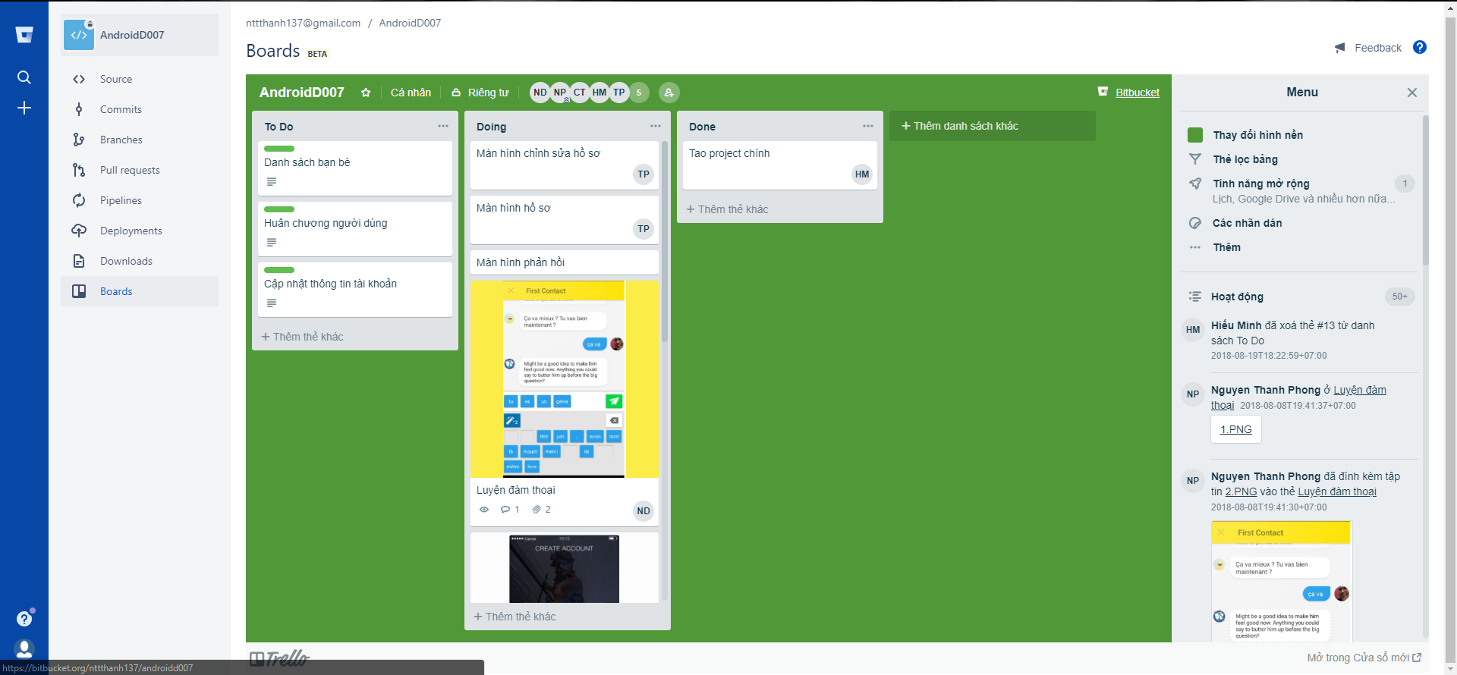
Tools
Bit Bucket
Notes:
Potential : khả năng
Encounter : gặp
Trivial : tầm thường

Slide 10
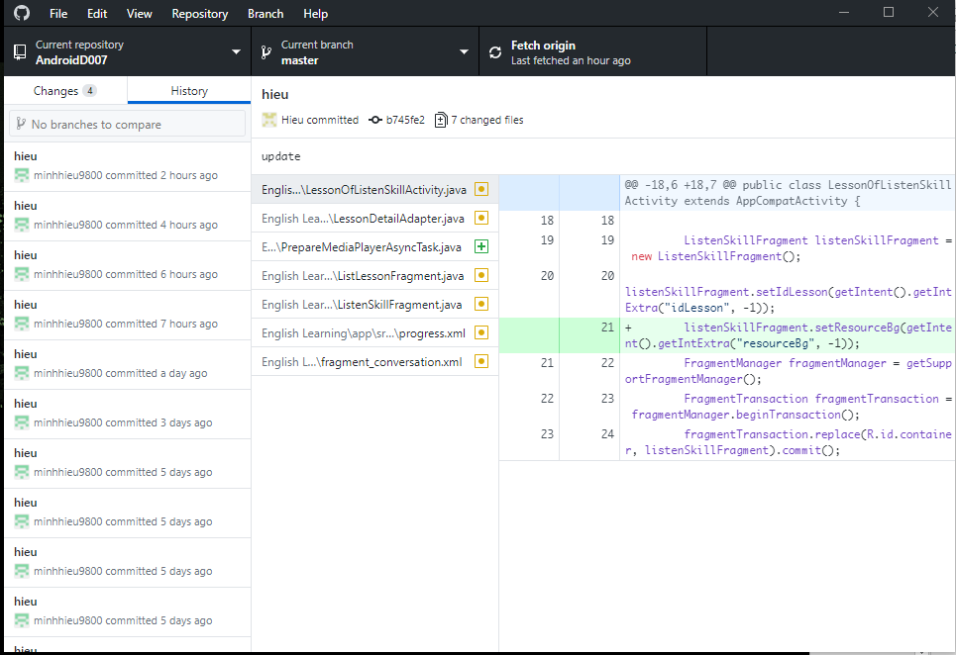
Tools
Github
Notes:
Potential : khả năng
Encounter : gặp
Trivial : tầm thường

Slide 11
3
Line of Code

Slide 12
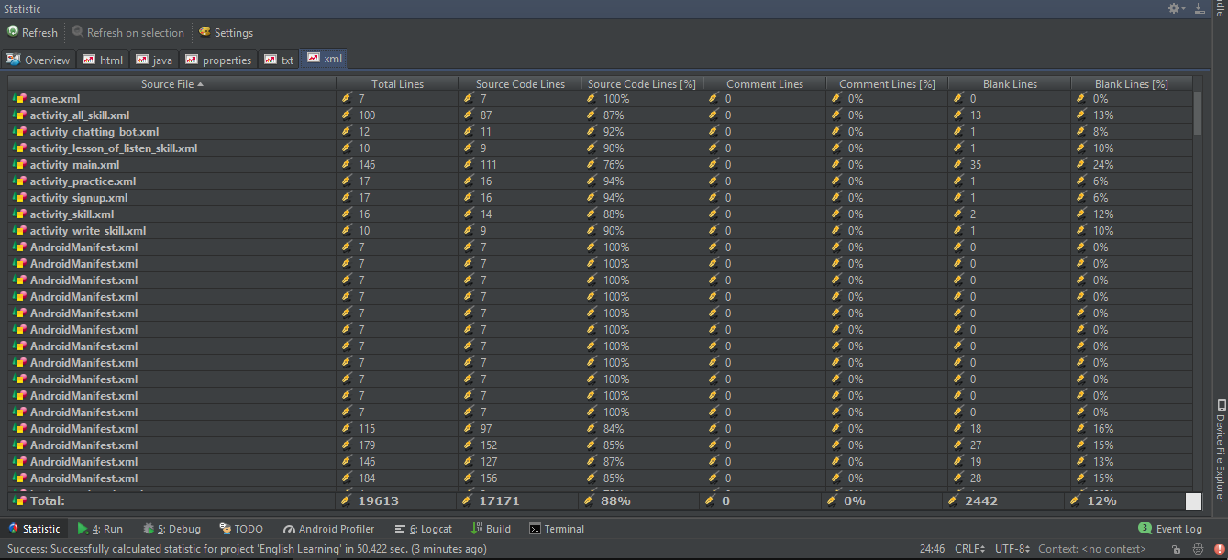
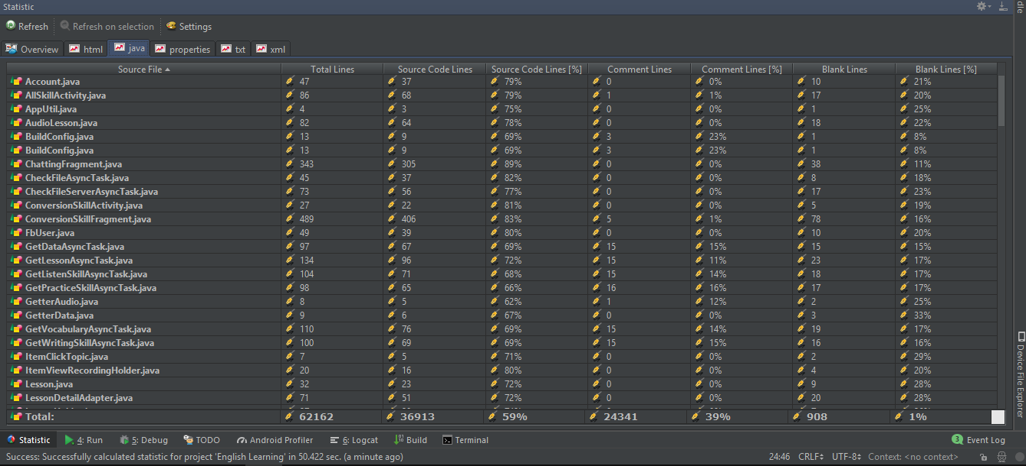
Line of Code
Notes:
Potential : tiềm năng
Encounter : gặp
Trivial : tầm thường

Slide 13
4
Details

Slide 14
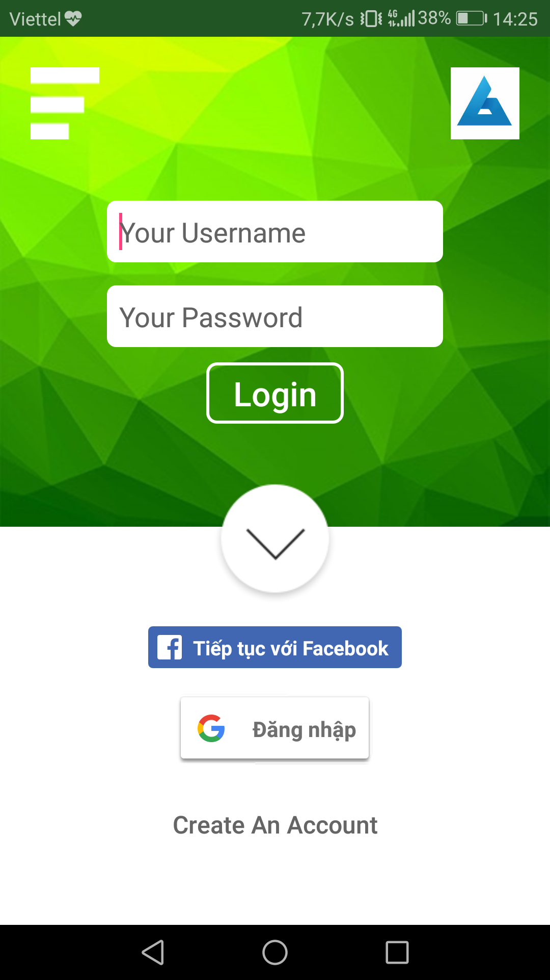
L
Details
Login
Login With facebook
Login with Google
Create new accounts
Notes:
Potential : tiềm năng
Encounter : gặp
Trivial : tầm thường

Slide 15
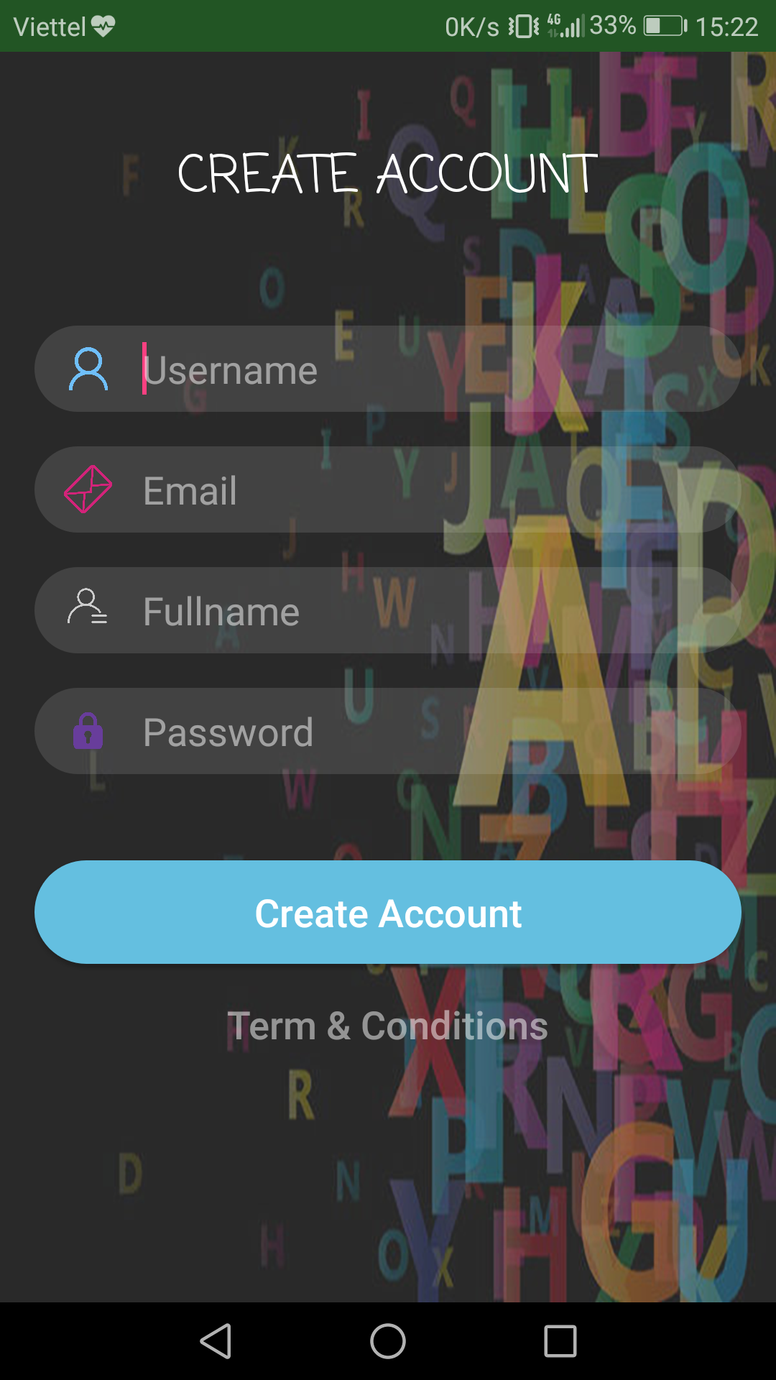
L
Details
Sign Up
Notes:
Potential : tiềm năng
Encounter : gặp
Trivial : tầm thường

Slide 16
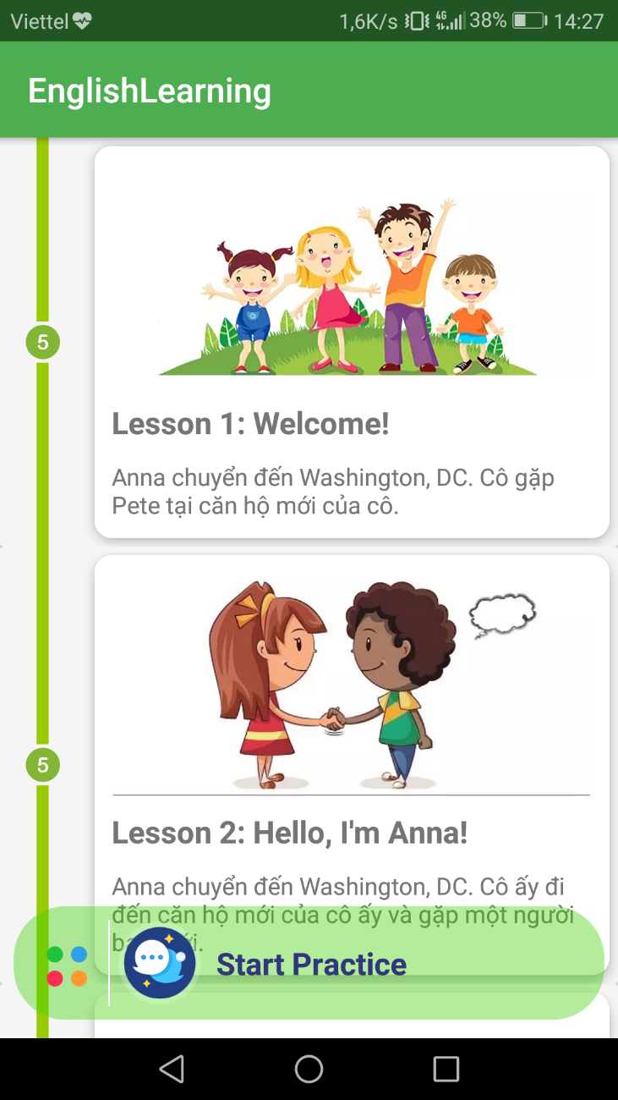
L
Details
Main
Notes:
Potential : tiềm năng
Encounter : gặp
Trivial : tầm thường

Slide 17
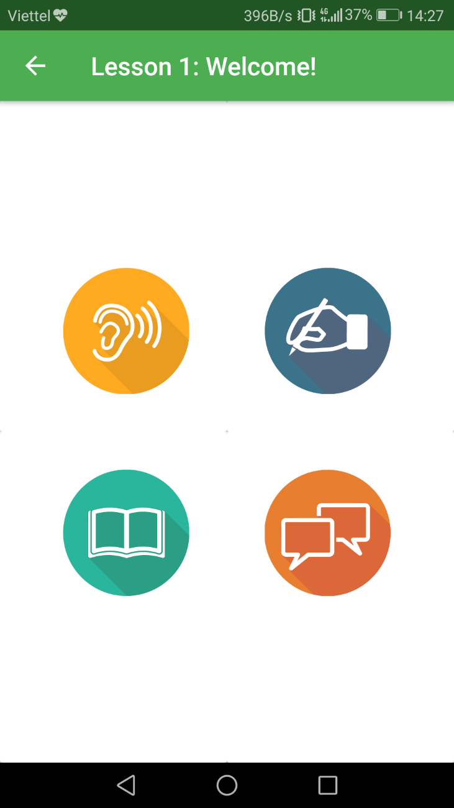
L
Details
Choose Lesson
Notes:
Potential : tiềm năng
Encounter : gặp
Trivial : tầm thường

Slide 18
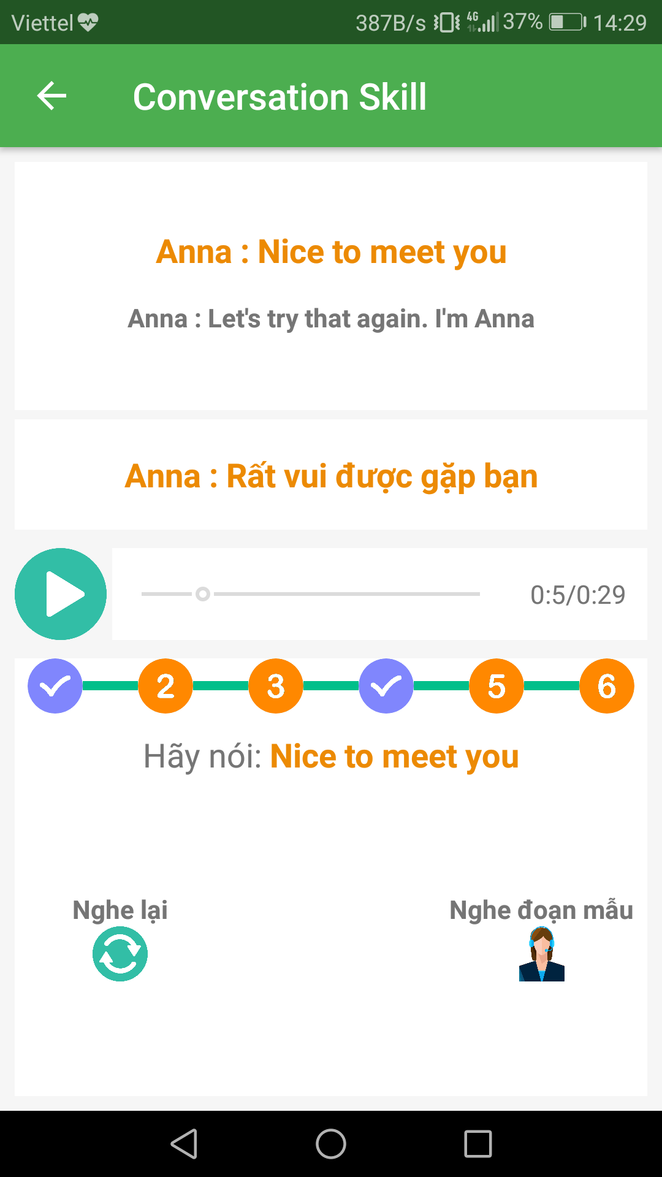
L
Details
Conversation Skill
Notes:
Potential : tiềm năng
Encounter : gặp
Trivial : tầm thường

Slide 19
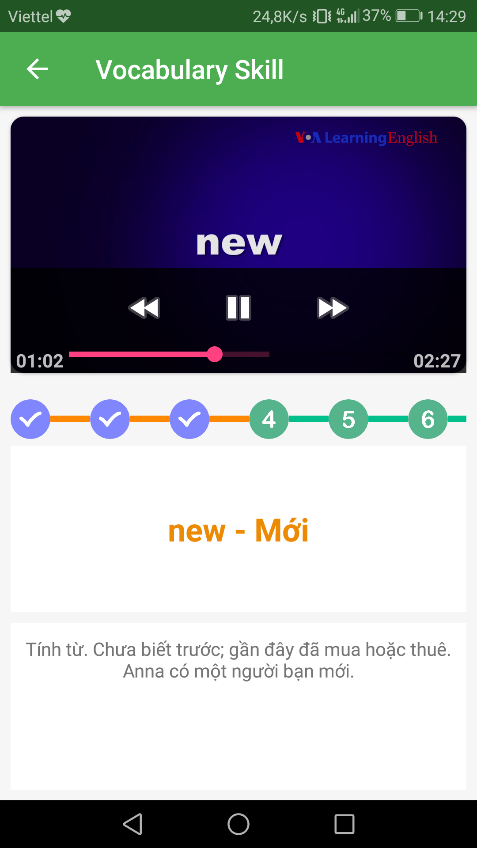
L
Details
Vocabulary Skill
Notes:
Potential : tiềm năng
Encounter : gặp
Trivial : tầm thường

Slide 20
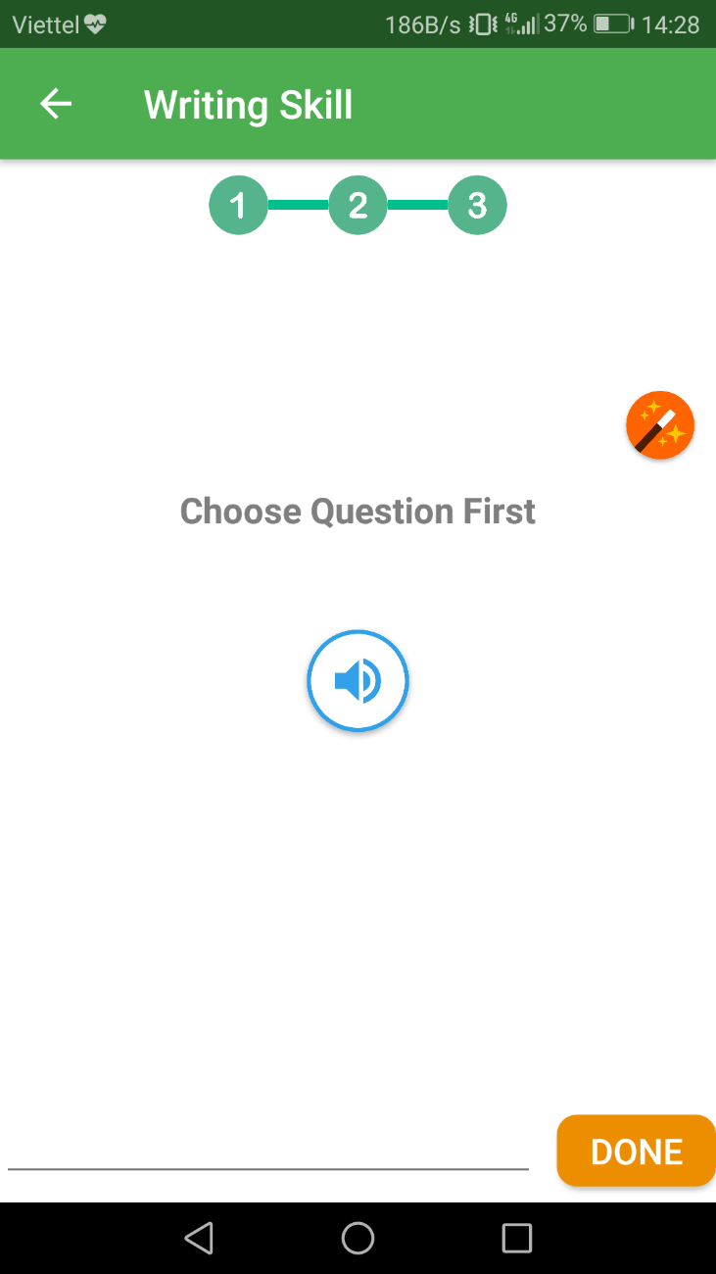
L
Details
Writing Skill
Notes:
Potential : tiềm năng
Encounter : gặp
Trivial : tầm thường

Slide 21
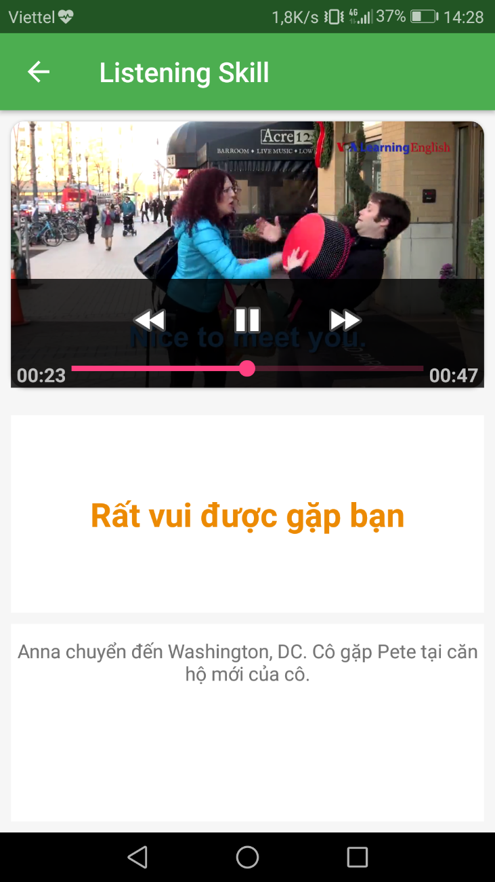
L
Details
Listening Skill
Notes:
Potential : tiềm năng
Encounter : gặp
Trivial : tầm thường

Slide 22
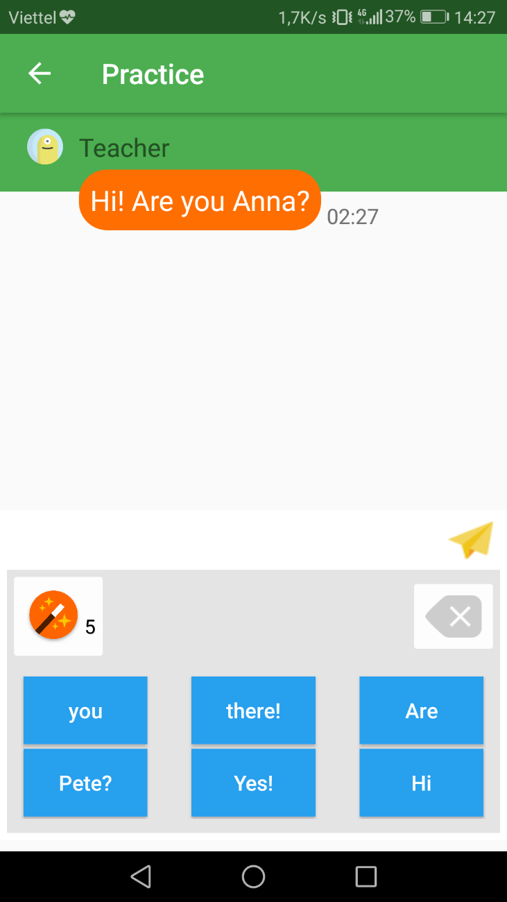
L
Details
Practice
Notes:
Potential : tiềm năng
Encounter : gặp
Trivial : tầm thường

Slide 23
5
Demo

Slide 24
6
Experience Product

Slide 25
THANKS
FOR YOUR
TIME

